Slide 1

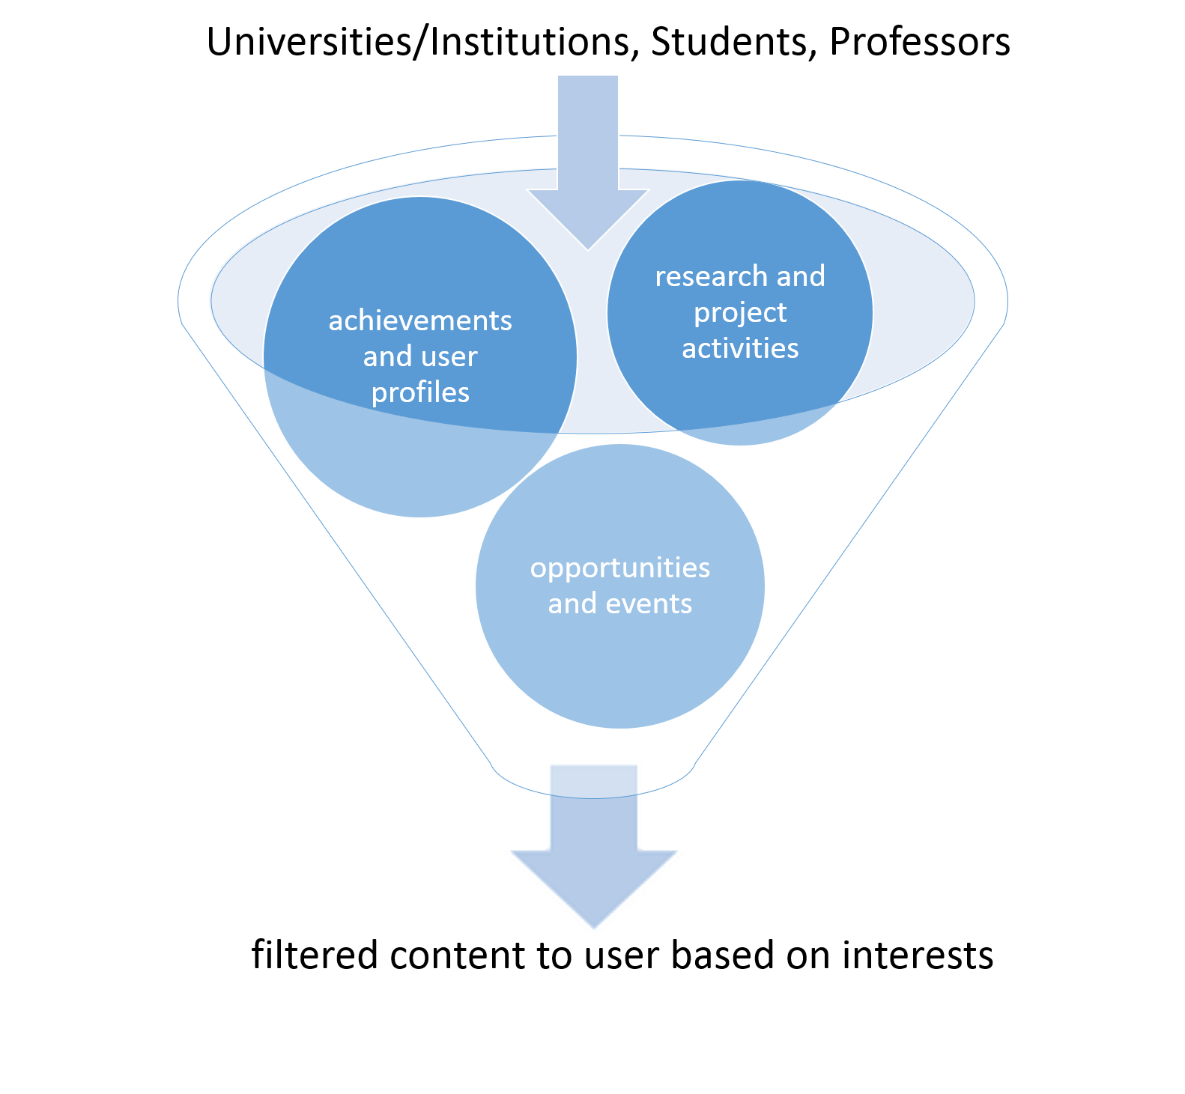
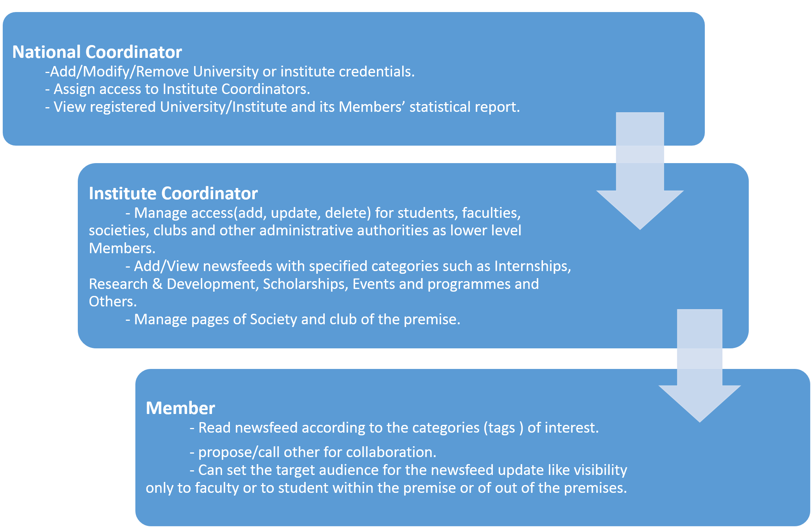
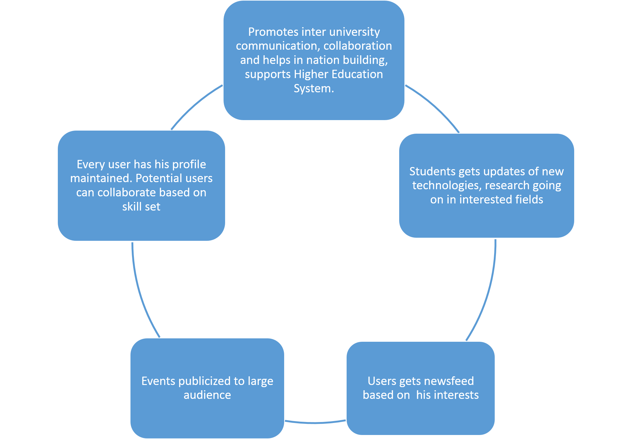
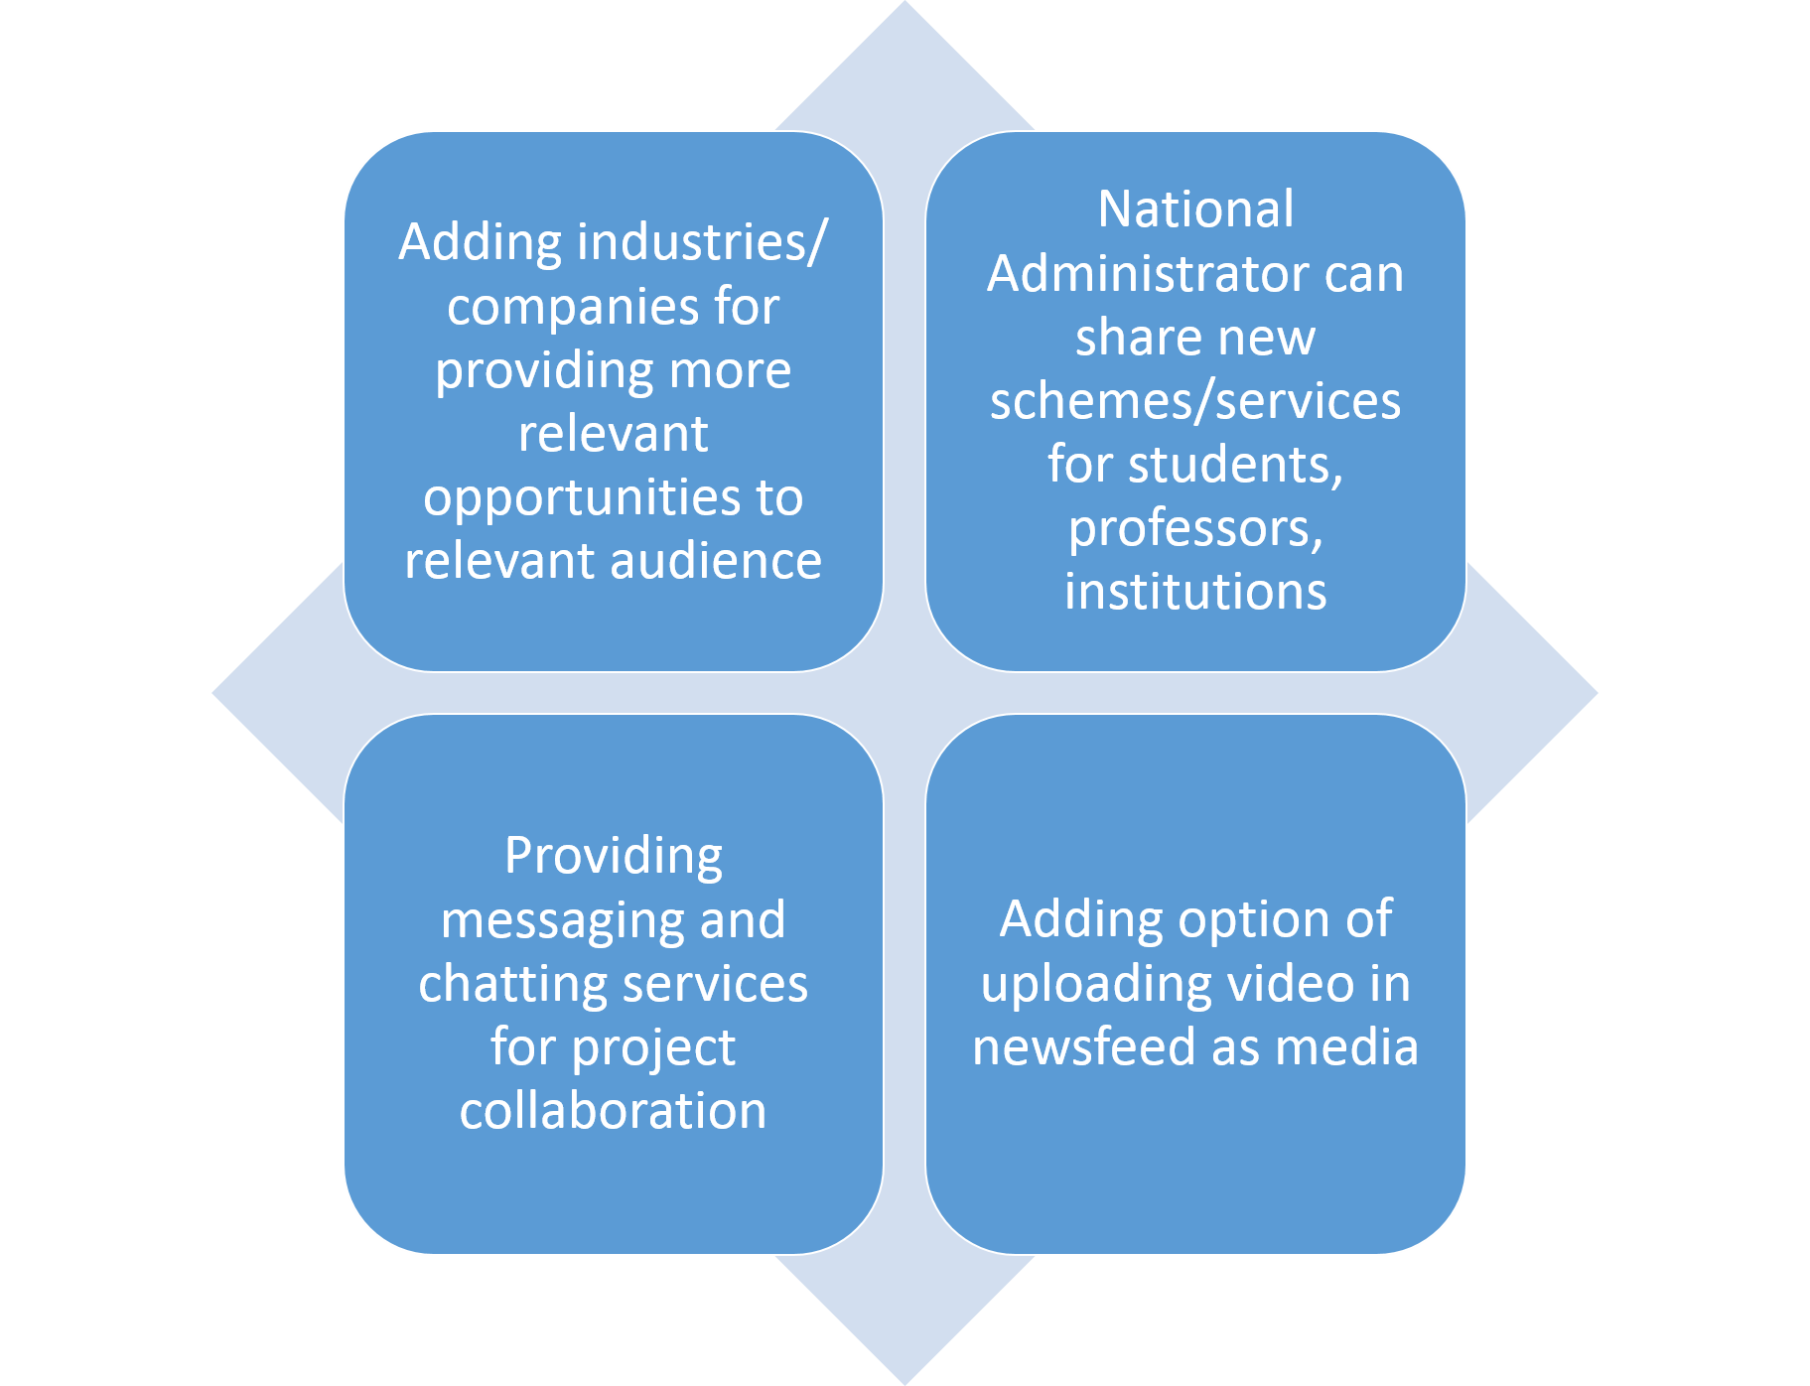
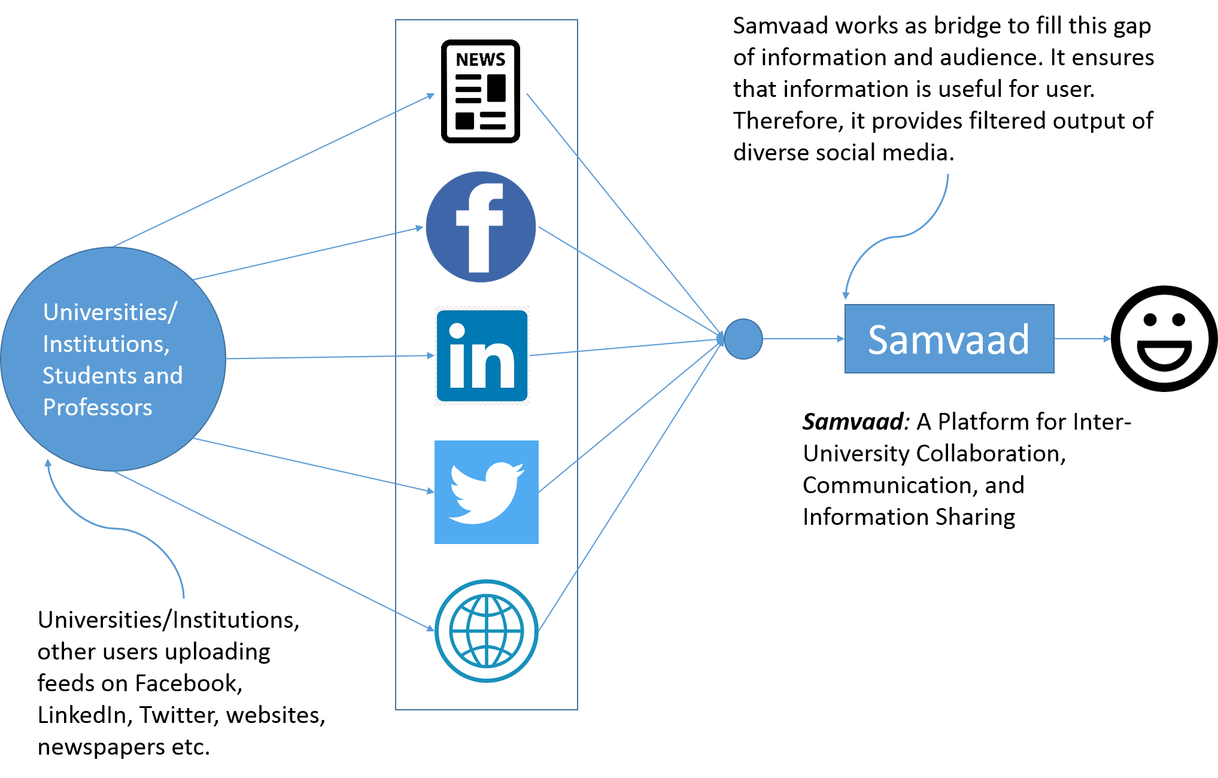
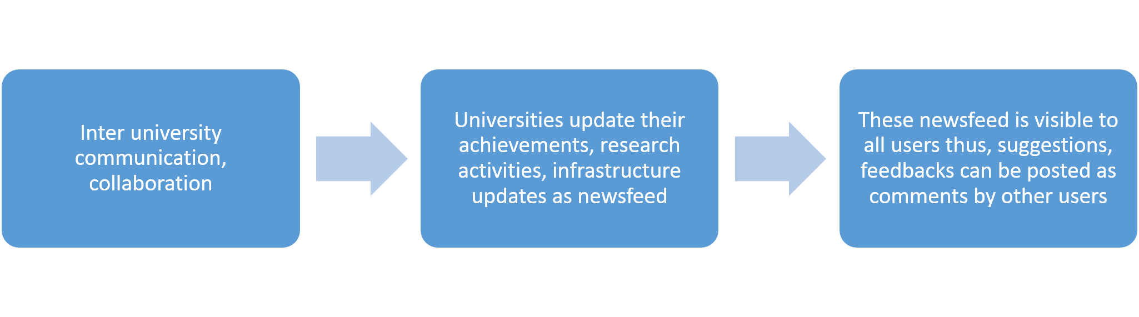
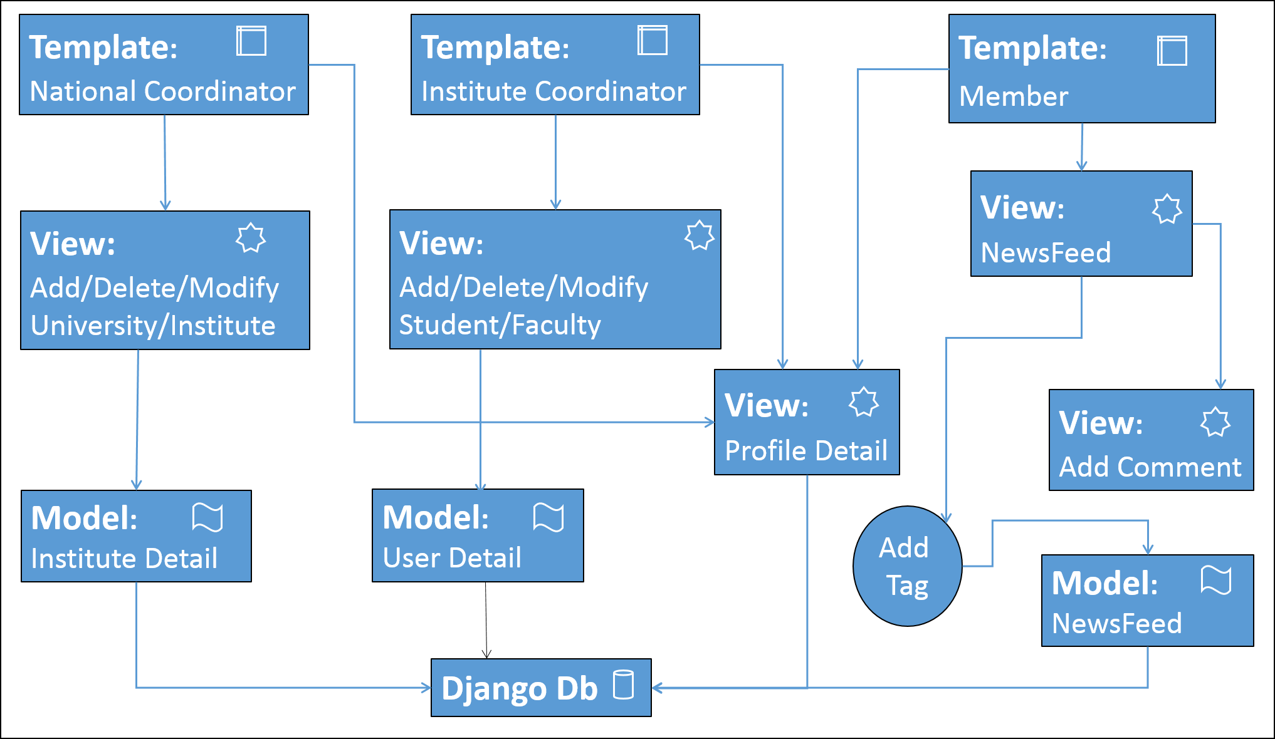
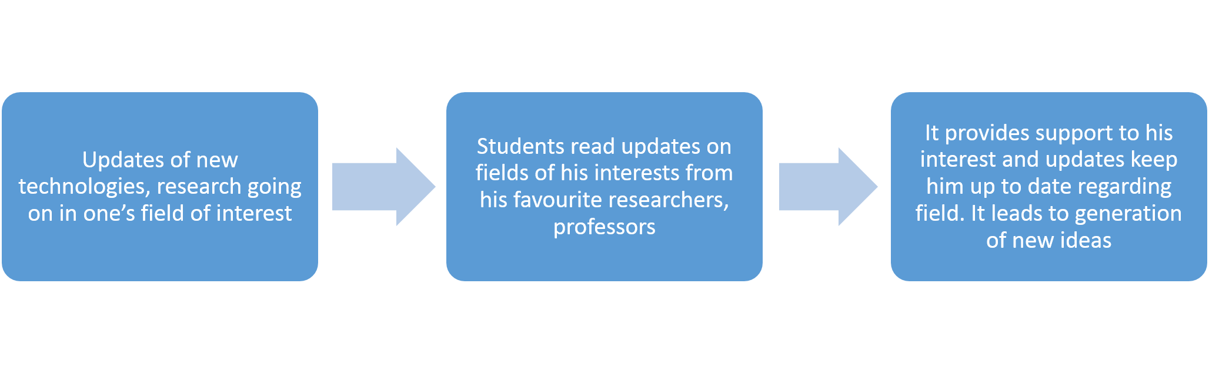
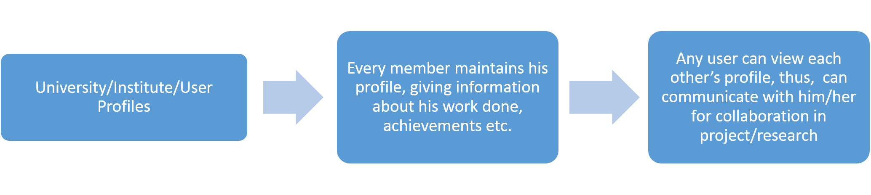
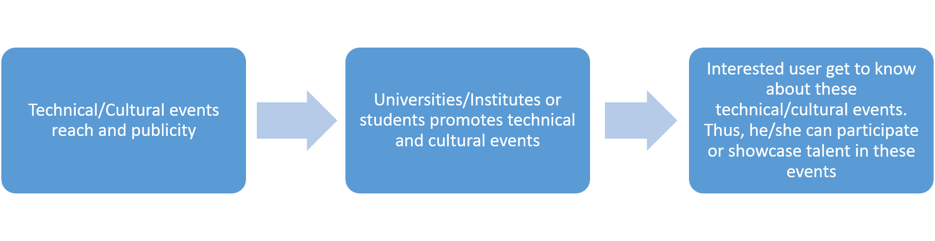
Guided by :-
Dr Kuldeep Kumar
Samvaad: A Platform for Inter-University Collaboration, Communication, and Information Sharing
Nitish Kumar and Harry Chhabra
Dr B R Ambedkar National Institute of Technology, Jalandhar
Abstract :-
Figure 1: Representation of abstract showing the filtration of information
Methodology and Implementation :-
Figure 3: Working model of the Samvaad with information on the access rights for the different
Figure 4: Block diagram for the Samvaad which is based on the MVT architecture supported by the Django framework
Result Analysis
Figure 5: Brief points on results of implementation of Samvaad
Figure 6: Result details of inter university communication and collaboration
Figure 7: Result details of updates of new technologies, research going on in one’s field of interest
Figure 8: Result details of University/Institute/User Profiles
Figure 9: Result details of Technical/Cultural events reach and publicity
Conclusion
1. Samvaad supports the Higher Educational System of India by providing required opportunities to students.
2. It increases the reach of universities/Institutes and promotes collaboration thus helps in development.
Future works
Figure 10: Representation of future works
Introduction
Figure 2: Representation showing the problem of ‘information sandwiching’ and solution provided as a common and easy to use platform ‘Samvaad’ :-
Acknowledgements
We would like to acknowledge the help provided by Dr, Kuldeep Kumar for his valuabe and constructive suggestions and Ms. Simran Kaur for her help in integrating front-end and backend.
Aim :-
Samvaad aims to provide a healthy platform for discussion, information sharing to students/faculties and supporting higher Indian education system.
References

Slide 2
Guided by :-
Dr Kuldeep Kumar
Samvaad: A Platform for Inter-University Collaboration, Communication, and Information Sharing
Nitish Kumar and Harry Chhabra
Dr B R Ambedkar National Institute of Technology, Jalandhar
Abstract :-
Methodology and Implementation :-
The Front-end of the Samvaad is designed using HTML, CSS, and Javascript.
backend is scripted in Django [3] using the SQL database.
Content classification APIs [4] based on machine learning are used to load the profile according to the user’s choice of interest.
Django uses the MVT (Model View Template) design structure. In MVT, the Model defines the structure of the entries in the database. The Template part defines the front end of the web application, and the View defines the interaction of the Model and Template.
Result Analysis :-
Samvaad, promotes inter university communication ,collaboration and helps in Nation building, support higher education system.
Student gets updates of new technologies, research going on in these fields.
Users gets newsfeed based on his interests.
Events got publisized to large audience.
Oppurtunitines by universities go to interested and large mass.
Every user has his profile mainainted. Potential users can collaborate based on skill set.
Conclusion :-
Samvaad, uses machine learning concepts to provide filtered content to the registered users. Every user is in the control of the upper-level user, therefore fake profiles and content can be easily omitted. It supports higher indian Education system so, the social impact is considerable large.
Introduction :-
Future works :-
Acknowledgements
We would like to acknowledge the help provided by Dr, Kuldeep Kumar for his valuabe and constructive suggestions and Ms. Simran Kaur for her help in integrating front-end and backend.
Aim :-
Samvaad aims to provide a healthy platform for discussion, information sharing to students/faculties and supporting higher Indian education system.
References

